Slide 1


Investigation of MnBi-based Composite Magnets
Parashu Kharel¹, Gavin Baker¹, Manish Neupane¹, and Tula R Paudel²
¹Department of Physics, South Dakota State University, Brookings, SD 57007, USA
² Department of Physics, South Dakota School of Mines and Technology, Rapid City, SD 57701, USA

Slide 2
Outline
Background and Motivation
Sample preparation
Results
Conclusions

Slide 3
Motivation and Background
High performance permanent magnetic materials are critical for modern technology including high-density recording, medical equipment, wind generators, and energy-efficient cars.
The most promising candidates of permanent magnets at present are the Dy-added Nd₂Fe₁₄B magnets.
Some promising candidates of rare-earth-free, low-cost permanent magnets: MnBi, Mn₂Ga, FeNi, (Fe, Co)₂B, YCo_{5,} and HfCo₇.
MnBi has a special advantage: The magnetic anisotropy increases with the increasing temperature reaching a maximum value of about 22 Mergs/cm³ at 590 K .
Low magnetization, residual Bi in the sample and poor corrosion stability of LTP phase are some issues with MnBi magnet.
Our goal is to improve the magnetization of MnBi making its composite with Fe particles.

Slide 4
Methods
Ingots of Mn₅₅Bi₄₅ and Mn₅₅Bi₄₅C_{x} were synthesized using arc-melting under an argon atmosphere followed by vacuum annealing (400 °C for 8 hours).
The composite samples were made by mixing crushed powder of MnBi with commercially available Fe nanoparticles, using mortar and pastel (about 15 minutes).
The crystal structure and magnetic properties were studied using x-ray diffraction and VersaLab magnetometer.

Slide 5
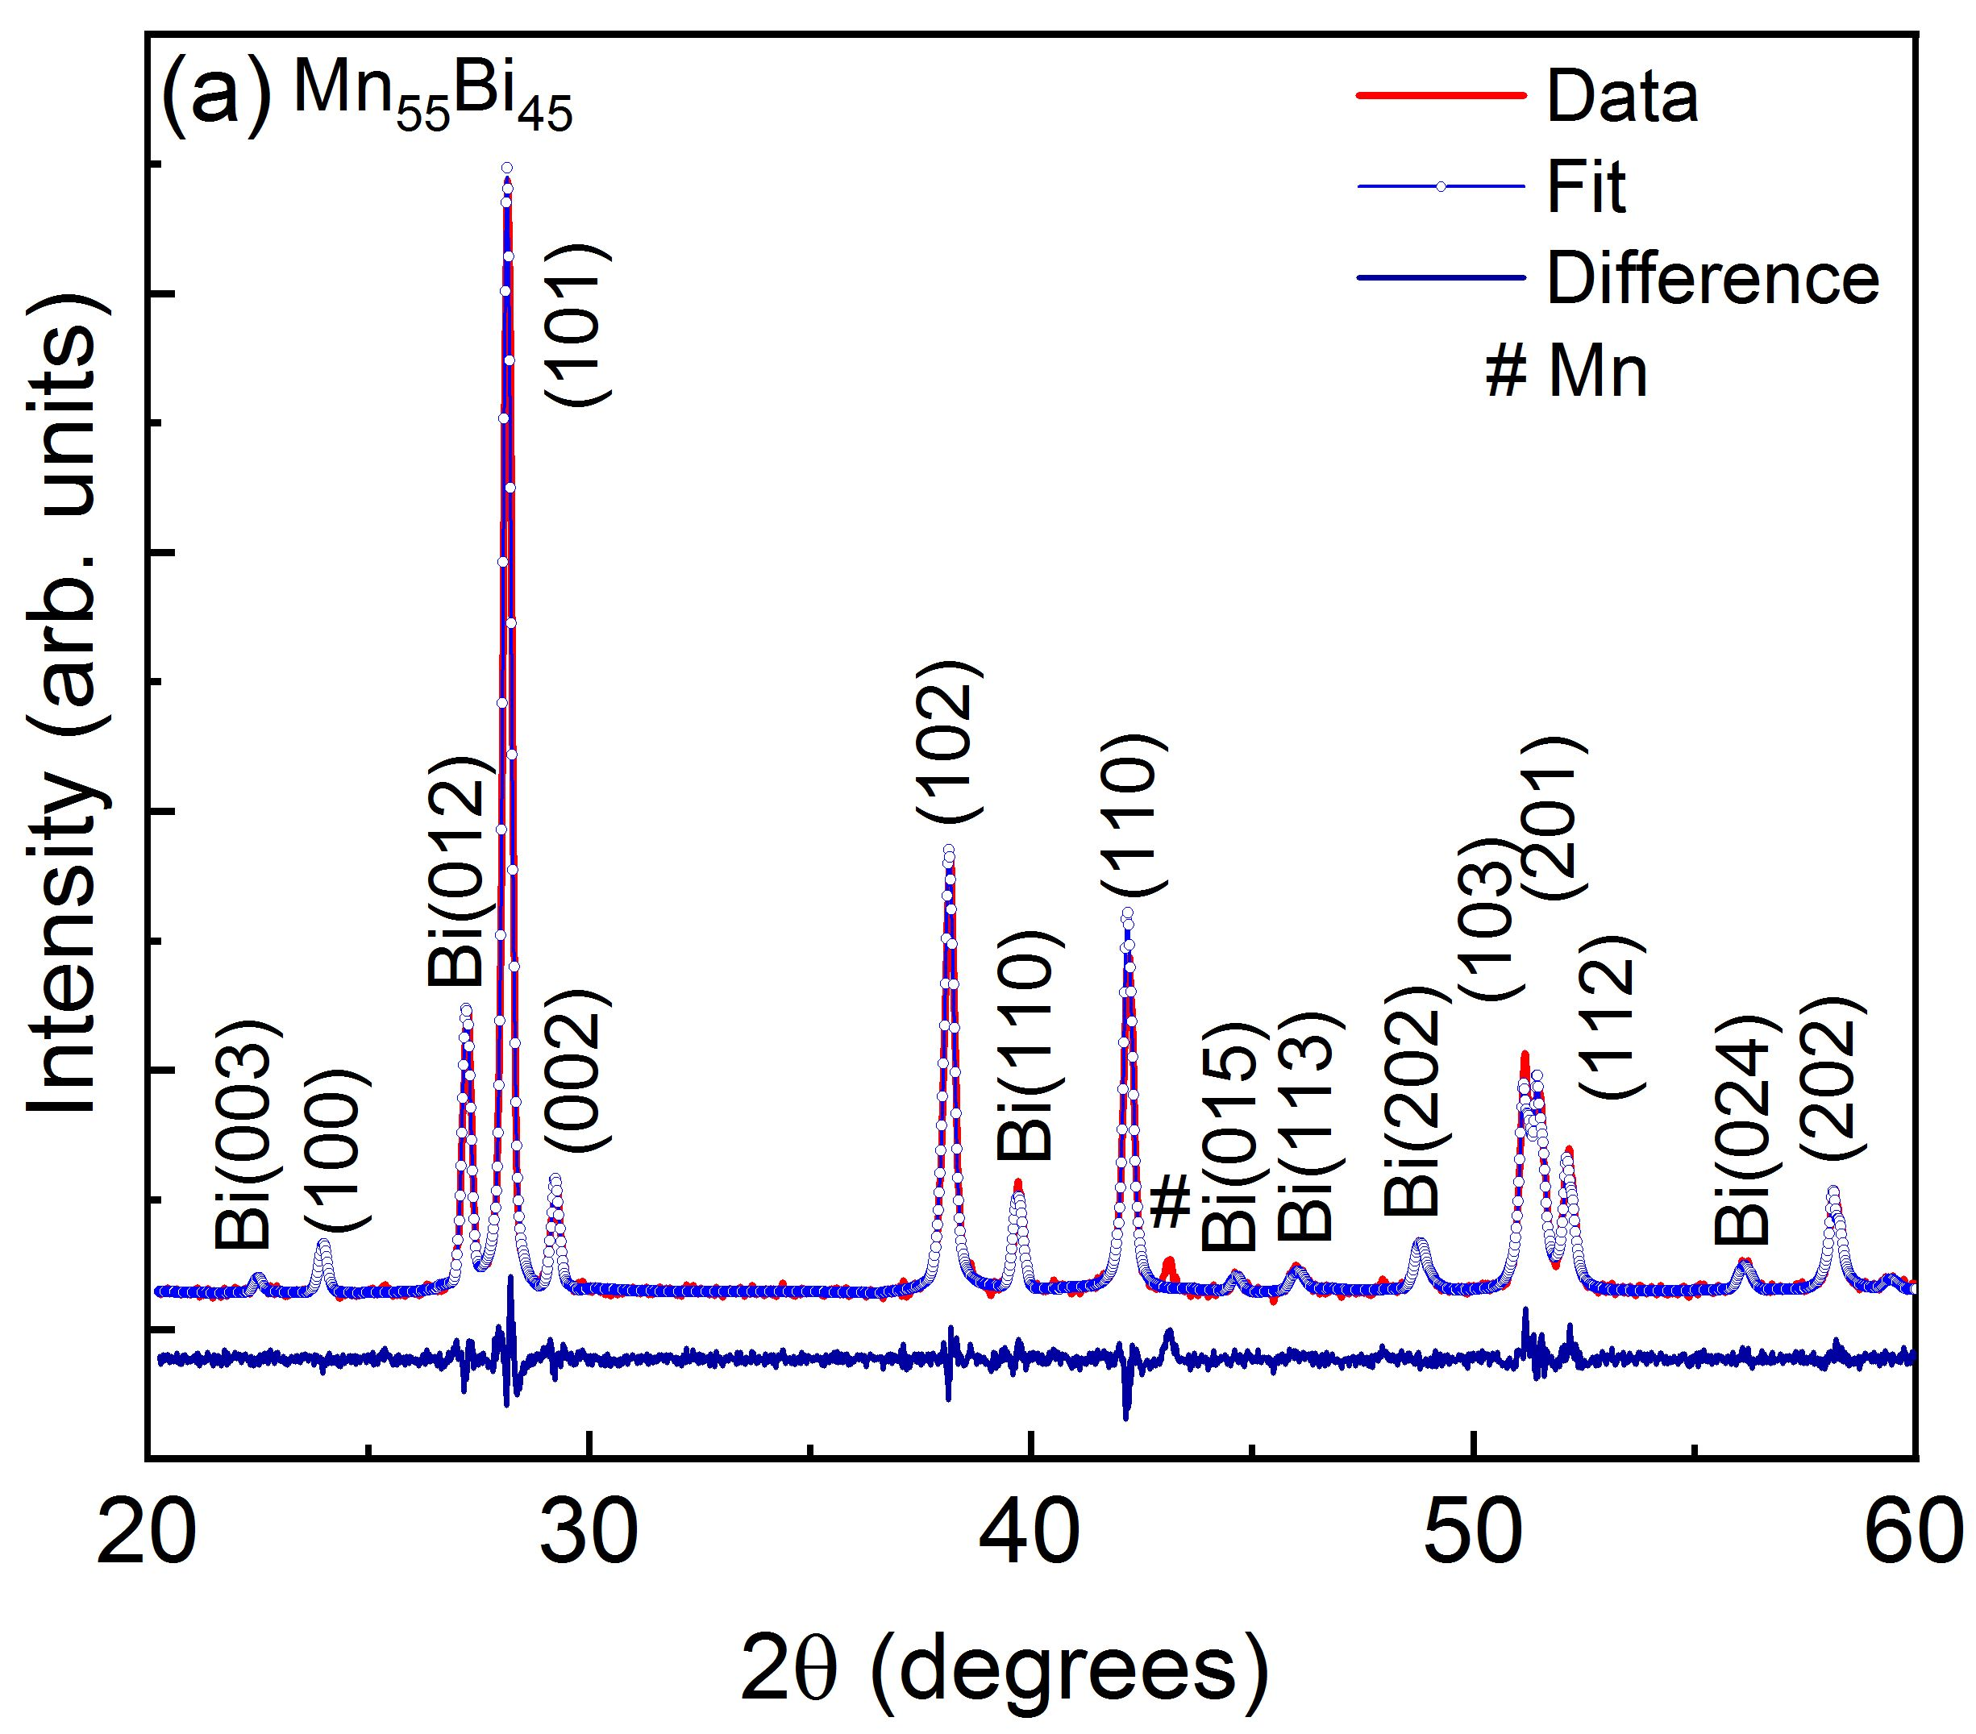
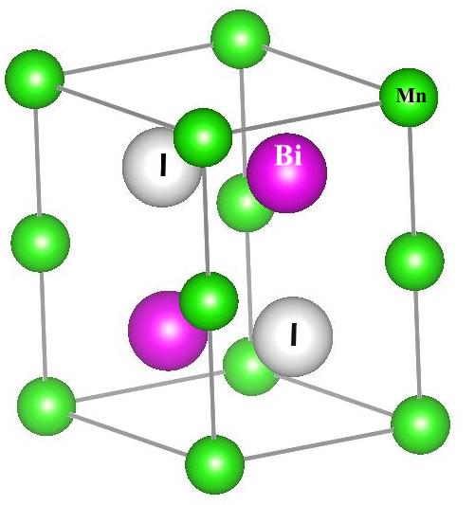
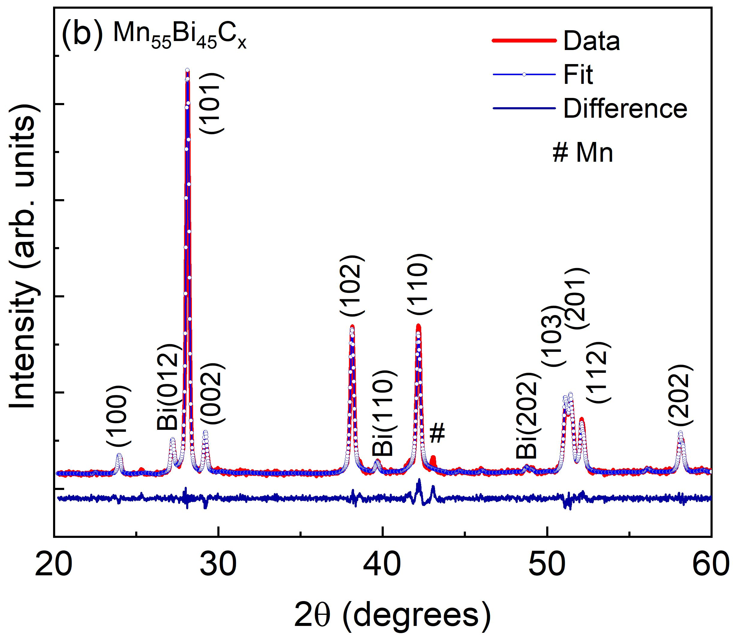
Crystal Structure
Bi = 16 wt.%
Bi = 5 wt.%
Both Mn₅₅Bi₅₄ and Mn₅₅Bi₄₅C_{x} samples show hexagonal NiAs-type structure (LTP).
P. Kharel et al., J. Phys. D: Appl. Phys. 55, 265003(2022).

Slide 6
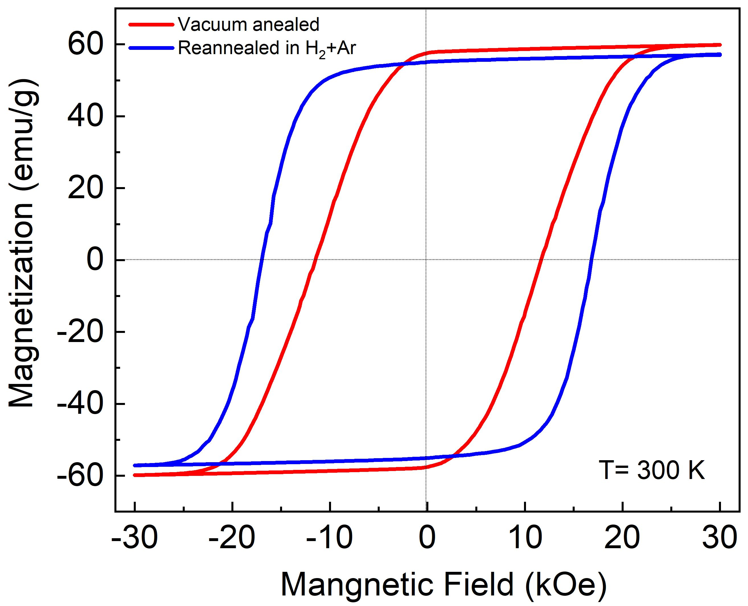

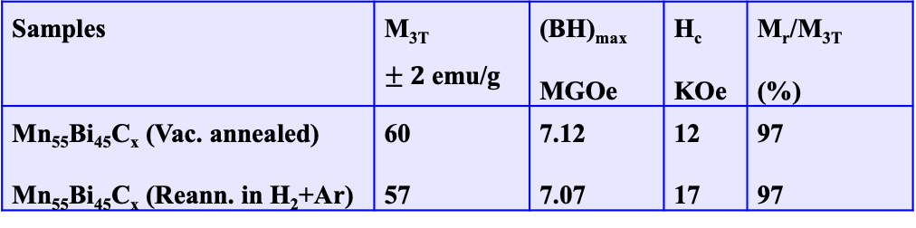
Magnetic Properties of MnBi: M(H)
MnBi single domain diameter: ~ 0.50 $μm$
Samples | M_{3T} $±2$emu/g | (BH)_{max} MGOe | H_{c} KOe | M_{r}/M_{3T} (%)
Mn₅₅Bi₄₅C_{x} (Vac. annealed) Mn₅₅Bi₄₅C_{x} (Reann. in H₂+Ar) | 60 57 | 7.12 7.07 | 12 17 | 97 97
Reannealing of MnBi powder under flow of H₂ and A₂ mixture has improved coercivity with little decrease in magnetization.
Reannealing: 350 ºC for 1 hour

Slide 7
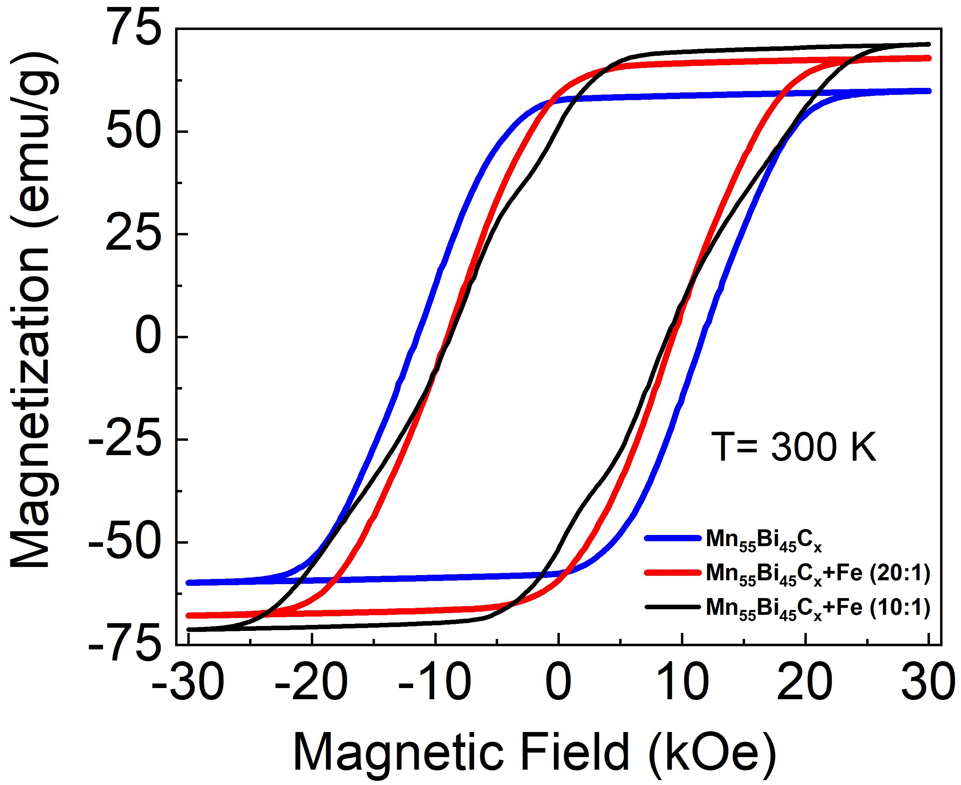
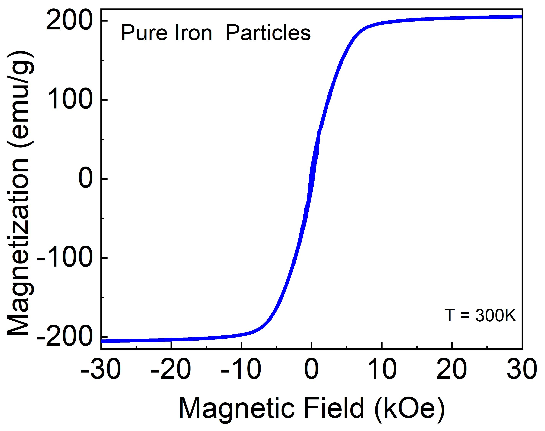
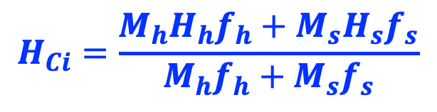

Magnetic Properties of MnBi and Fe: M(H)
The saturation magnetizations of composite samples are consistent with the value calculated using
$M_{3T}=M_{3T,s}f_{s}+M_{3T,h}f_{h}$
Expected Coercivity:
$$H_{Ci}=\frac{M_{h}H_{h}f_{h}+M_{s}H_{s}f_{s}}{M_{h}f_{h}+M_{s}f_{s}}$$
J. Park et al., Scientific reports, 7, 4960(2017).

Slide 8
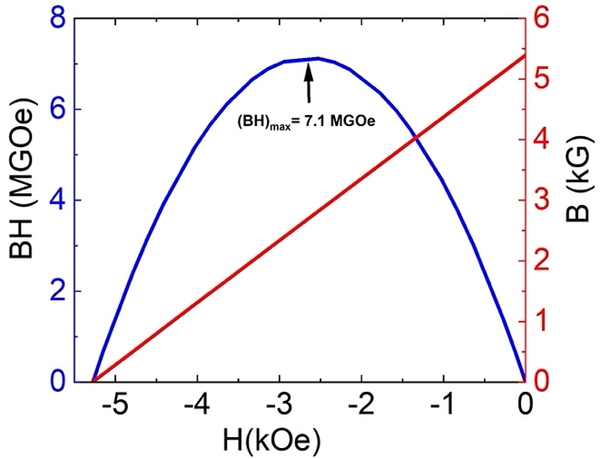
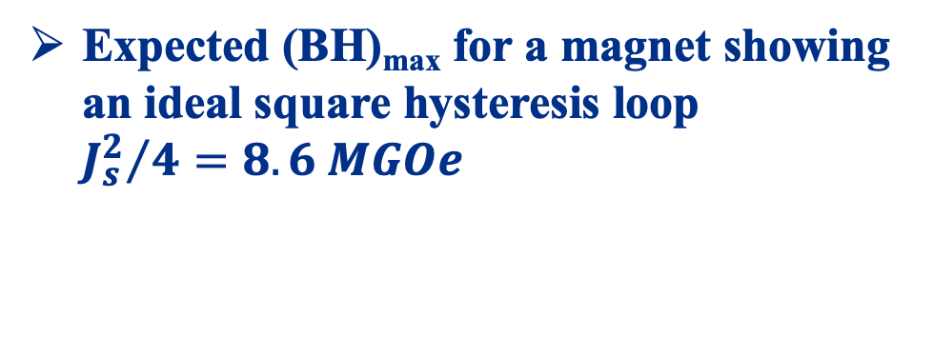
Energy product Mn₅₅Bi₄₅C_{x}
Expected (BH)_{max} for a magnet showing an ideal square hysteresis loop ${J_{s}^{2}}/{4=8.6 MGOe }$

Slide 9
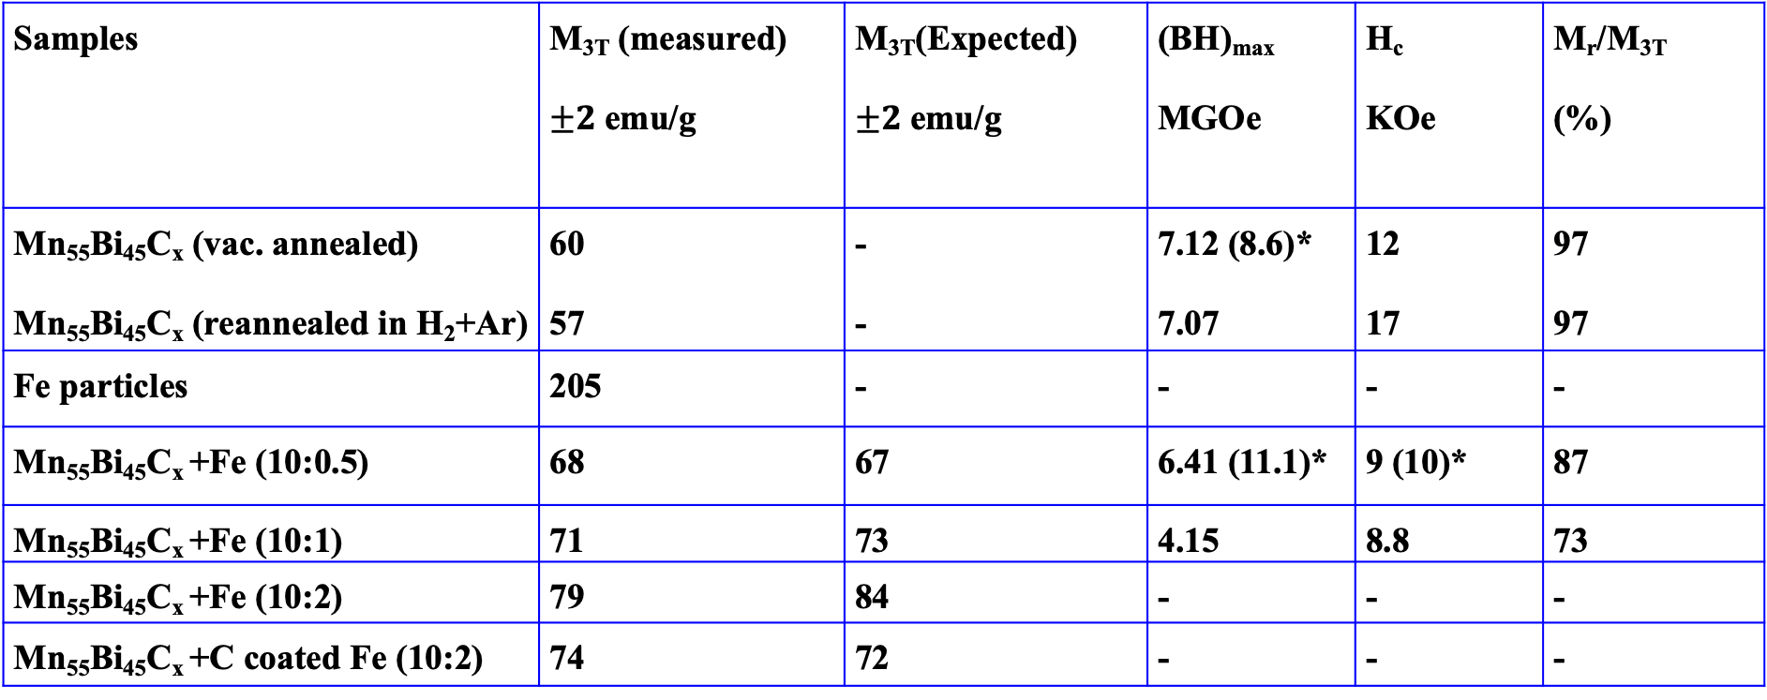
Magnetic Properties: Summary
Samples | M_{3T} (measured) $±2$emu/g | M_{3T}(Expected) $±2$emu/g | (BH)_{max} MGOe | H_{c} KOe | M_{r}/M_{3T} (%)
Mn₅₅Bi₄₅C_{x} (vac. annealed) Mn₅₅Bi₄₅C_{x} (reannealed in H₂+Ar) | 60 57 | - - | 7.12 (8.6)* 7.07 | 12 17 | 97 97
Fe particles | 205 | - | - | - | -
Mn₅₅Bi₄₅C_{x} +Fe (10:0.5) | 68 | 67 | 6.41 (11.1)* | 9 (10)* | 87
Mn₅₅Bi₄₅C_{x} +Fe (10:1) | 71 | 73 | 4.15 | 8.8 | 73
Mn₅₅Bi₄₅C_{x} +Fe (10:2) | 79 | 84 | - | - | -
Mn₅₅Bi₄₅C_{x} +C coated Fe (10:2) | 74 | 72 | - | - | -
*Expected value

Slide 10
Conclusions
We investigated the structural and magnetic properties of Mn₅₅Bi₄₅ C_{x} and composite of Mn₅₅Bi₄₅ C_{x} with Fe nanoparticles.
Mn₅₅Bi₄₅ C_{x} powder reannealed in a flow of Ar + H₂ gas mixture shows significant increase in coercivity.
The composite of Mn₅₅Bi₄₅ C_{x} with Fe particles showed expected increase in magnetization, but the energy product was not improved due to low M_{r}/M_{s.}
The composite samples with Mn₅₅Bi₄₅C_{x} : Fe = 10:1 and with higher Fe concentration showed an indication of phase separation.
With further improvement in magnetization and squareness of hysteresis loop, it is possible to develop MnBi-based rare-earth-free permanent magnet.

Slide 11
Thank you very much!

